Slide 1
Parts and Functions of a Compound Microscope

Slide 2
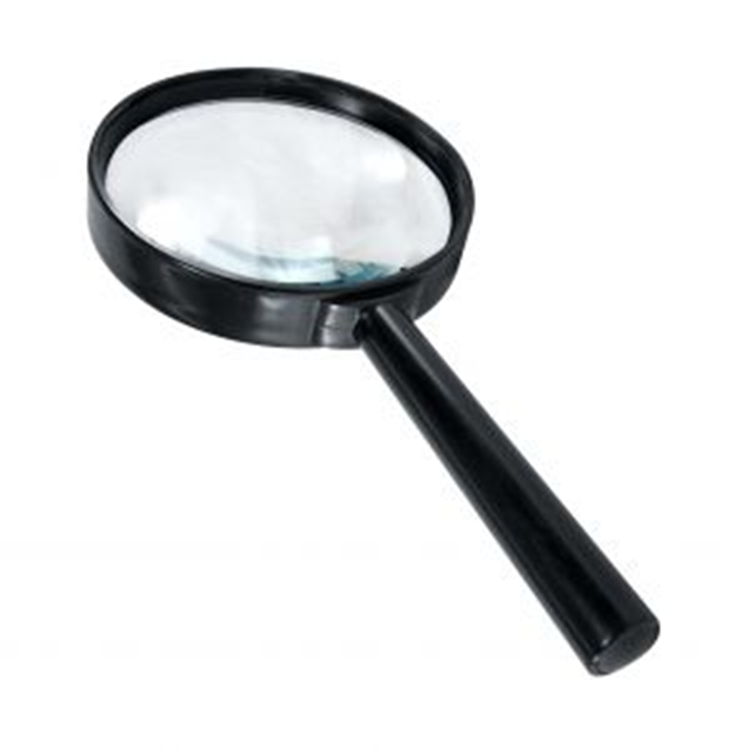
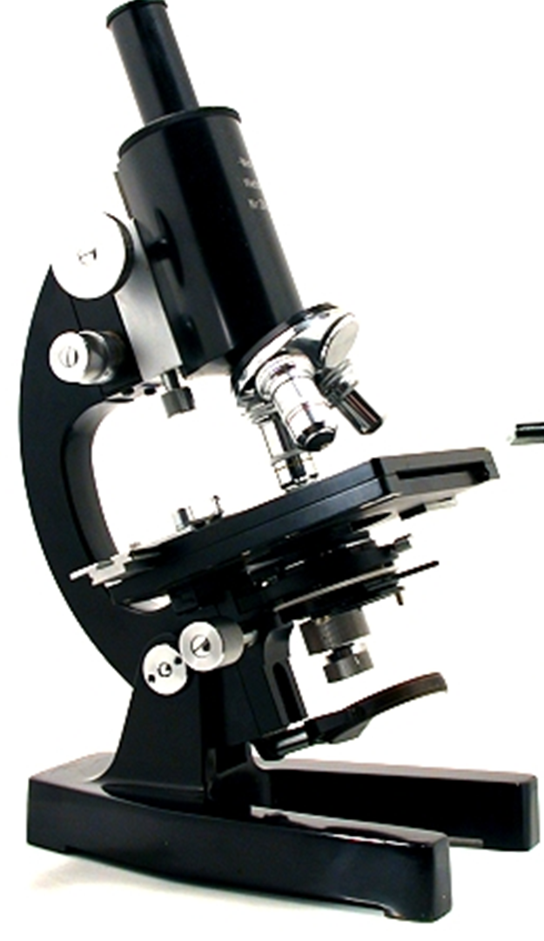
Light Microscope
Simple – uses a single lens.
Compound – uses a set of lenses or lens systems (this is the type of microscope we use in class, it has the eyepiece lens (ocular) and the objective lens)

Slide 3
Compound Microscope – no need to write
Mechanical Parts
Used to support and adjust the parts
Magnifying Parts
Used to enlarge the specimen
Illuminating Parts
Used to provide light

Slide 4
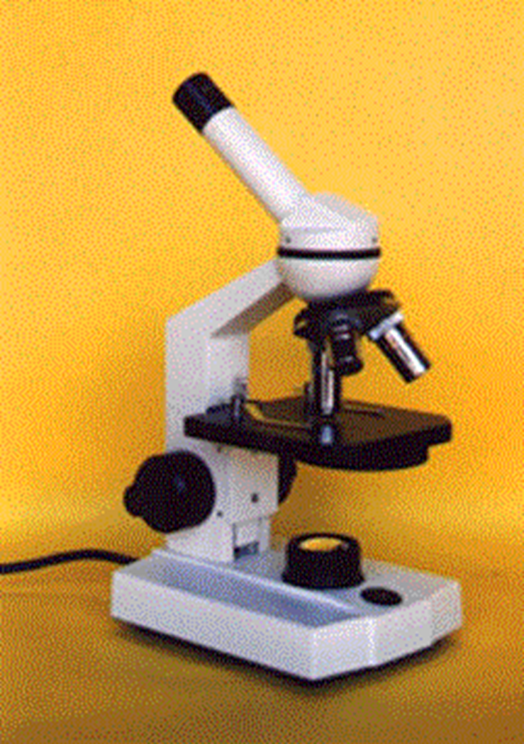
Arm
Base

Slide 5
Mechanical Parts
Base
Bottom most portion that supports the entire/lower microscope (you carry it by this and the arm)
Arm
Curved/slanted part which is held while carrying the microscope.

Slide 6
Stage
Platform where the slide containing the specimen is placed.
Stage Clips
Secure the slide to the stage.
Specimen
an individual animal, plant, mineral etc. (or piece of any of these things)

Slide 7
Glass Slide
- thin flat piece of glass,(about 1 mm thick) used to hold specimens.
Specimen
A piece or whole animal, plant, mineral etc. to be studied or observed.

Slide 8
Eyepiece
This is the part of the microscope you look through to see the specimen.
Diaphram
This allows more or less light through the stage to the specimen.

Slide 9
Course Focus –
Allows you to move the plane of focus up or down.
Fine Focus
Brings the little details of the specimen into the clearest view.

Slide 10
Nosepiece –
The part that holds the objectives and allows you to switch easily between them.
Objective lenses –
These parts allows you to magnify the specimen.

Slide 11
Plane of focus –
The horizontal area of the specimen that is in focus, it is horizontal to the slide and very thin <0.1mm in thickness.
Field of view –
The area of the slide that you can see. The lower the objective the LARGER the area is.

Slide 12
Parfocal – when the specimen is in focus with one objective, it will be with all.

Slide 13
When you have something in the field of view in the blue area, it will be gone when you switch from 4x to 10x
Field of view -
4X
10X
40X

Slide 14
Total magnification
You must multiply the optical lens magnification (in the eyepiece) by the objective lens magnification (in the objective).
So 10X objective with a 10X eyepiece = 100X total magnification.

Slide 15
The image orientation
When you look at an image it will reverse the image left to right (mirrored image).

Slide 16
9 things true of living organisms
They use energy.
They exchange gases.
They need this liquid (water).
They make waste.
They change size or grow.
Some in the species must reproduce.
They respond to stimuli.
They are made of cells which contain DNA (and/or RNA)

Slide 17
Body Tube
Attached to the arm and bears the lenses
Draw Tube
Cylindrical structure on top of the body tube that holds the ocular lenses

Slide 18
Draw Tube
Body Tube
Arm / Neck
Stage

Slide 19
Revolving/Rotating Nosepiece
Rotating disc where the objectives are attached
Dust Shield
Lies atop the nosepiece and keeps dust from settling on the objectives

Slide 20
Dust Shield
Revolving Nosepiece

Slide 21
Coarse Adjustment Knob
Geared to the body tube which elevates or lowers when rotated bringing the object into approximate focus
Fine Adjustment Knob
A smaller knob for delicate focusing bringing the object into perfect focus

Slide 22
Coarse Adjustment Knob
Fine Adjustment Knob

Slide 23
Condenser Adjustment Knob
Elevates and lowers the condenser to regulate the intensity of light
Iris Diaphragm Lever
Lever in front of the condenser and which is moved horizontally to open/close the diaphragm

Slide 24
Iris Diaphragm Lever
Condenser Adjustment Knob

Slide 25
Illuminating Parts
Mirror
Located beneath the stage and has concave and plane surfaces to gather and direct light in order to illuminate the object
Electric Lamp
A built-in illuminator beneath the stage that may be used if sunlight is not preferred or is not available

Slide 26
Mirror / Electric Lamp

Slide 27
Substage
Iris Diaphragm
Regualtes the amount of light necesaary to obtain a clearer view of the object
Condenser
A set of lenses between the mirror and the stage that concentrates light rays on the specimen.

Slide 28
Iris Diaphragm
Condenser

Slide 29
MAGNIFYING PARTS
Ocular / Eyepiece
Another set of lens found on top of the body tube which functions to further magnify the image produced by the objective lenses. It usually ranges from 5x to 15x.

Slide 30
Ocular

Slide 31
MAGNIFYING PARTS
Objectives
Metal cylinders attached below the nosepiece and contains especially ground and polished lenses
LPO / Low Power Objective
Gives the lowest magnification, usually 10x
HPO / High Power Objective
Gives higher magnification usually 40x or 43x
OIO / Oil Immersion Objective
Gives the highest magnification, usually 97x or 100x, and is used wet either with cedar wood oil or synthetic oil

Slide 32
Objectives

Slide 33
Use of the Compound Microscope

Slide 34
Make sure all backpacks are out of the aisles before you get a microscope!
Always carry the microscope with one hand on the Arm and one hand on the Base. Carry it close to your body.

Slide 35
Be gentle.
Setting the microscope down on the table roughly could jar lenses and other parts loose.

Slide 36
Always start and end with lowest powered objective.

Slide 37
Place the slide on the microscope stage, with the specimen directly over the center of the glass circle on the stage (directly over the light).
Notes:
Then you have a 9 out of 10 chance of finding the specimen as soon as you look through the eyepiece!

Slide 38
If you wear glasses, take them off; if you see only your eyelashes, move closer.
If you see a dark line that goes part way across the field of view, try turning the eyepiece.

Slide 39
Use only the Fine adjustment knob when using the HIGH (long) POWER OBJECTIVE.
As much as possible, keep both eyes open to reduce eyestrain. Keep eye slightly above the eyepiece to reduce eyelash interference.

Slide 40
If, and ONLY if, you are on LOW POWER, lower the objective lens to the lowest point, then focus using first the coarse knob, then the fine focus knob.
Notes:
The specimen will be in focus when the LOW POWER objective is close to the lowest point, so start there and focus by slowly raising the lens. If you can’t get it at all into focus using the coarse knob, then switch to the fine focus knob.

Slide 41
Adjust the Diaphragm as you look through the Eyepiece, and you will see that MORE detail is visible when you allow in LESS light!
Too much light will give the specimen a washed-out appearance.
Notes:
Once you have found the specimen on Low Power (100x), unless specifically asked to draw it on low power, center the specimen in your field of view, then, without changing the focus knobs, switch it to High Power. If you don’t center the specimen you will lose it when you switch to High Power (Yellow).

Slide 42
Once you have it on High Power remember that you only use the fine focus knob!
The High Power Objective (40x) is very close to the slide. Use of the coarse focus knob will scratch the lens, and crack the slide.
Notes:
NEVER USE THE RED LENS. It is an oil immersion lens. Without the oil to lubricate the lens, you will destroy it!
Also, the oil is needed to help gather enough light to actually see through the lens!

Slide 43
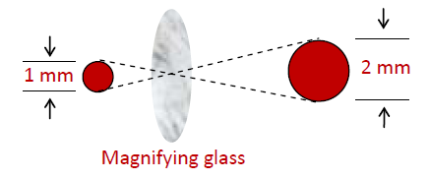
MAGNIFICATION
The ratio of the original image to the “magnified” image.
Notes:
For example, if we looked at a 1 mm diameter dot with a magnifying glass we can measure the dot as it appears through the lens of the glass. If the dot after magnification is 2 mm, then the magnification is 2x

Slide 44
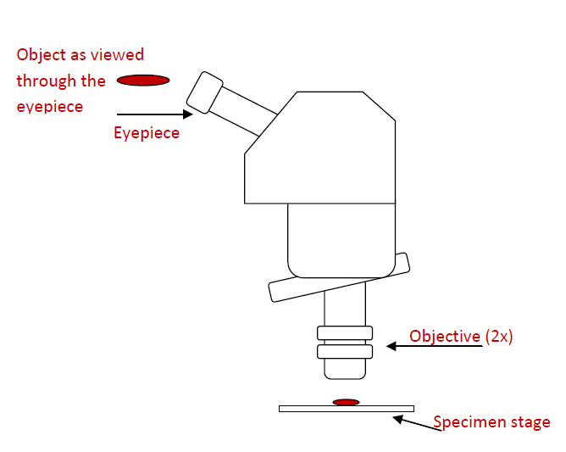

Slide 45
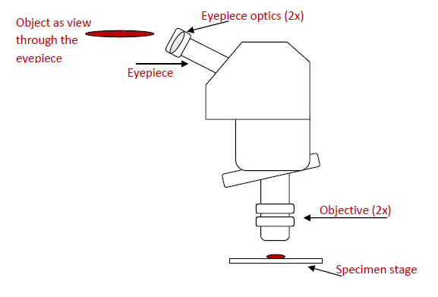

Slide 46
RESOLUTION
limiting distance between two points at which they are perceived as distinct from one another.

Slide 47
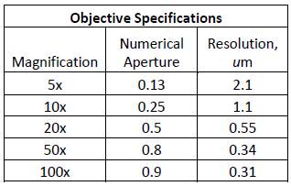

Slide 48
Numerical Aperture
the amount of light that which enters the objective.
The larger the NA, the greater the resolving power of the objective.

Slide 49
Mounting
Glass Slide - thin flat piece of glass, typically 75 by 25 mm (3 by 1 inches) and about 1 mm thick, used to hold objects for examination under a microscope.
Cover Slip

Slide 50
Mounting
1. Gather a thin slice/piece of whatever your specimen is. If your specimen is too thick, then the coverslip will wobble on top of the sample like a see-saw:

Slide 51
2. Place ONE drop of water directly over the specimen.
Notes:
If you put too much water over the specimen, then the coverslip will float on top of the water, making it harder to draw the specimens as they float past the field of view!

Slide 52
Place the coverslip at a 45 degree angle (approximately), with one edge touching the water drop, and let go.

Slide 53
Staining
A technique in microscopy that is used to enhance the image of the specimen.
To distinguish structures in cells and tissues

Slide 54
How to Stain a Slide
1. Place one drop of stain on one edge of the coverslip, and the flat edge of a piece of paper towel on the other edge of the coverslip. The paper towel will draw the water out from under the coverslip, and the cohesion of the water will draw the stain under the coverslip.

Slide 56
As soon as the stain has covered the area containing the specimen you are finished. The stain does not need to be under the entire coverslip. If the stain does not cover the area needed, get a new piece of paper towel and add more stain until it does.

Slide 57
3. Be sure to wipe off the excess stain with a paper towel, so you don’t end up staining the objective lenses.

Slide 58
4. You are now ready to place the slide on the microscope stage. Be sure to follow all the instructions as to how to use the microscope.

Slide 59
5. When you have completed your drawings, be sure to wash and dry both the slide and the coverslip and return them to the correct places!

